Slide 1
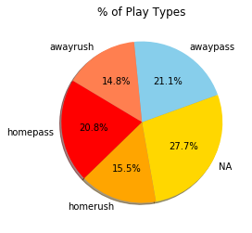
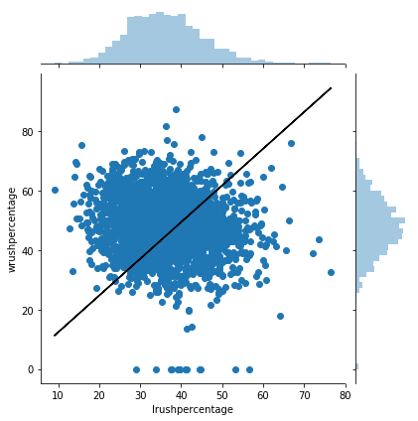
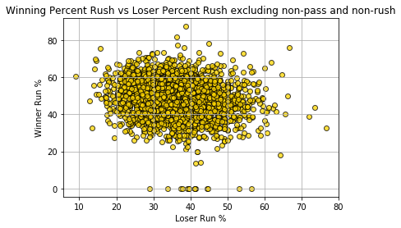
Run vs Pass Percentage
slope = -0.1831318642246357
intercept = 54.37651172870549
Intercept after y intercept of 0
= 1.23518623
r_squared = 0.02612809546691491
r_value = -0.16164187411347009
p_value = 2.988333035295909e-16

Slide 2
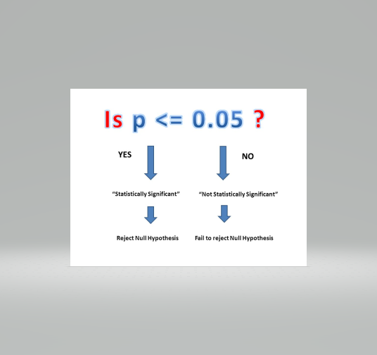
P-value Run Percentage vs Pass Percentage
Given that (p_value = 2.988333035295909e-16 < .05) we see Loser and Winner percentage is statistically significant
and would reject Null Hypothesis
Null Hypothesis – Run percentage does not influence winning percentage

